Slide 1



Feasibility Study and Implementation of EV Conversions for Motorcycles in Sri Lanka
E/19/169
JAYAWARDHANA H.D.S.M.
Department of Mechanical Engineering
University of Peradeniya
Supervisor : Ms.Lekha Bakmeedeniya,
University of Peradeniya
Co – Supervisor : Eng. Tharanga Wickramarathna,
Project Manager,
Ceylon Electricity Board

Slide 2


Agenda Overview
01
Introduction
06
Work Completed
02
Objectives
07
Conversion Kit
03
Timeline
08
Challenges & Mitigations
04
Literature Review Insights
09
Future Work & Expected Outcomes
05
Innovative Idea
10
Conclusion

Slide 3
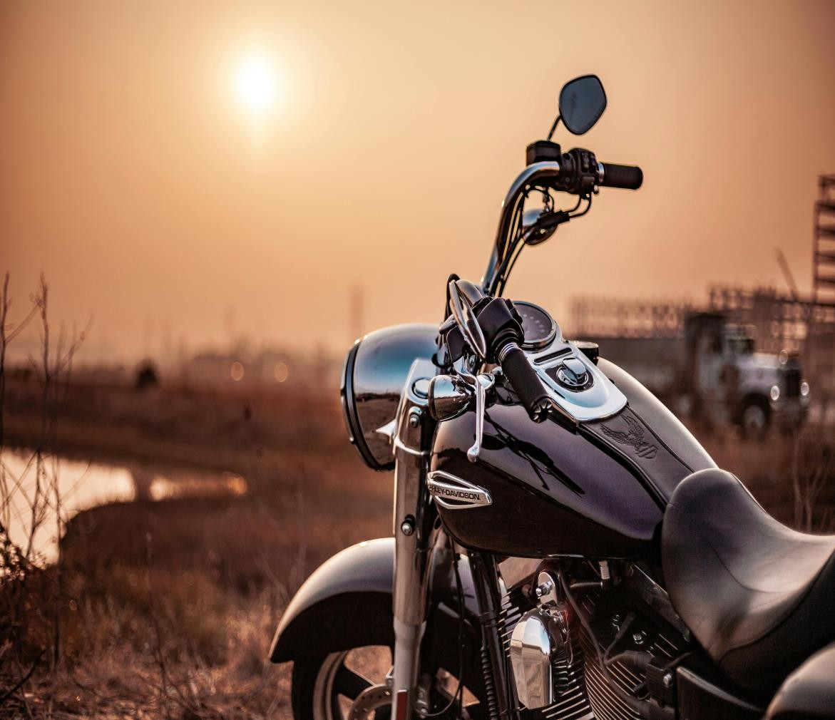

Introduction
Challenges in Sri Lanka’s Transport Sector:
High reliance on fossil fuels
Significant greenhouse gas emissions
High fuel costs impacting the economy
Project Goal:
Develop sustainable
Cost-effective EV conversion solutions for motorcycles.
Innovative Idea:
Introducing the concept of plug-in hybrid motorcycles (Electric + Fuel).

Slide 4
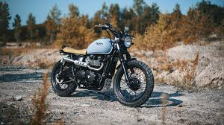

Objectives
Technical Feasibility: Evaluate and select optimal components.
Design Optimization: Balance weight, speed, and range.
Financial Feasibility: Assess costs and potential savings.
Scaling Recommendations: Propose renewable energy integration and policy
frameworks.

Slide 5



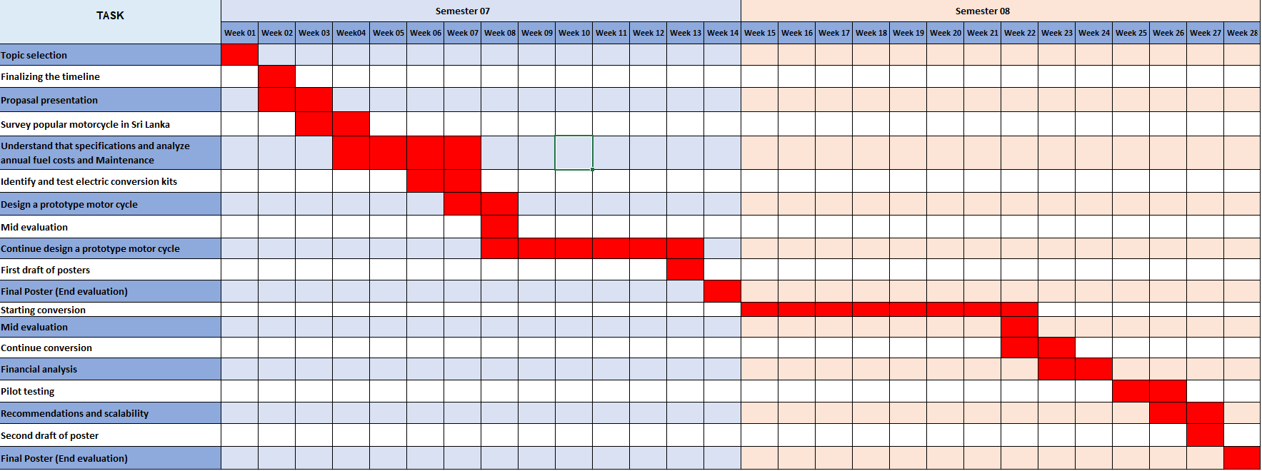
Timeline

Slide 6


Literature Review Insights
Global EV Retrofitting Practices:
Subsidies and incentives in Indonesia and Nepal.
Successful use of BLDC motors and lithium-ion batteries.
Challenges Identified:
High initial costs.
Limited charging infrastructure.
Environmental and Economic Benefits:
Emission reduction.
Lower operating costs.

Slide 7
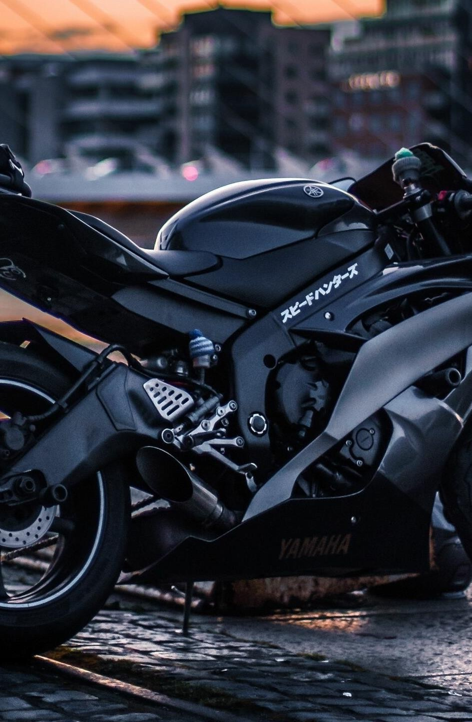
Innovative Idea
INNOVATIVE IDEA : Plug-in Hybrid Model
What is a Plug-in Hybrid Model?
Combines an electric drivetrain with a fuel engine.
Switchable modes: Electric for short commutes, Fuel for long-range.
Benefits:
Addresses range anxiety.
Reduces fuel consumption.
Suitable for areas with limited charging infrastructure.

Slide 8

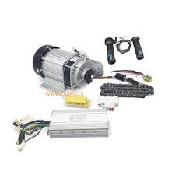
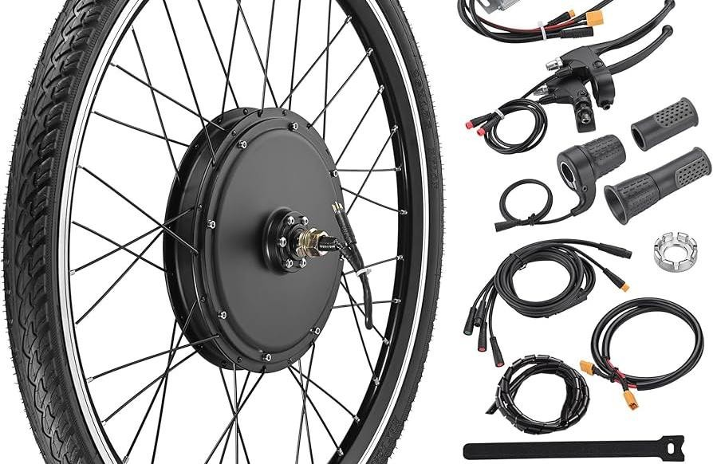
Conversion Kit
Chosen Conversion Kit for Bajaj CT 100 ,
Kit Components:
17" Alloy/Spokes 1800W Hub Motor
1800W Controller
Display Meter
3-Speed Forward/Reverse Throttle
Horn, Ignition Key, Anti-Theft Alarm
10A DC Converter and 3-Pin Charging Wire
48V 60Ah LiFePO4 Battery
Why Bajaj CT 100?
Popular model in Sri Lanka with wide user base.

Slide 9
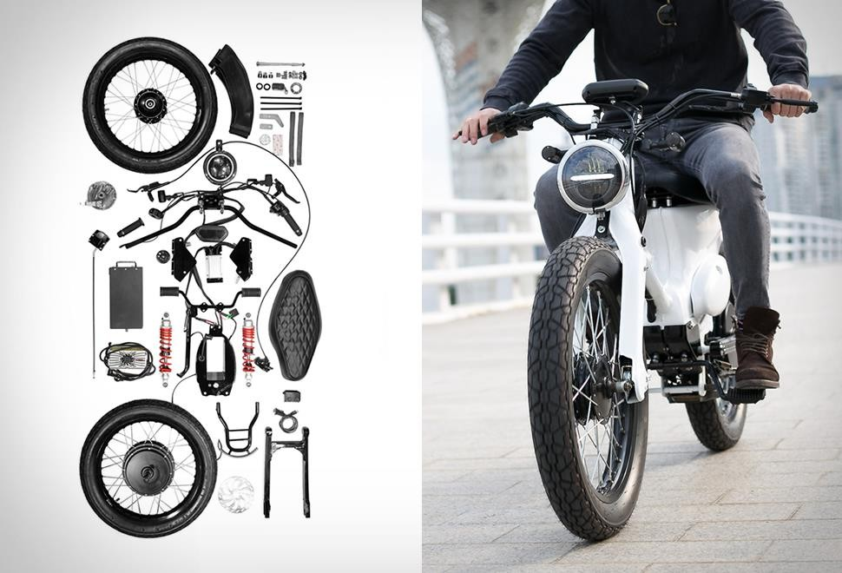
Motor & Battery selection
Motor Selection Calculations:
Total Resistance Force: 96.947 N
Required Power: 1.616 kW (~1616 W)
Selected Motor: 48V 1800W, 4400 RPM
Battery Selection Calculations:
Motor Current: 37.5 A
Battery Energy: 2250 Wh
Required Ampere-Hour: 46.875 Ah
Chosen Battery: 48V 60Ah LiFePO4

Slide 10
Work Completed
In semester 07,
Data Collection:
Surveys and interviews with motorcycle users.
Analysis of fuel consumption and user preferences.
Component Research:
Verified compatibility of the conversion kit with the Bajaj CT 100.
Started Preliminary Design Work:
3D models in SolidWorks and AutoCAD.

Slide 11

Challenges & Mitigations
Component Integration:
Challenge: Combining electric and fuel systems.
Mitigation: Research advanced controllers for smooth switching.
Battery Costs:
Challenge: High costs of lithium-ion batteries.
Mitigation: Propose modular designs to reduce upfront costs.
Public Resistance:
Challenge: Range anxiety and maintenance concerns.
Mitigation: Real-time energy monitoring for user confidence.

Slide 12
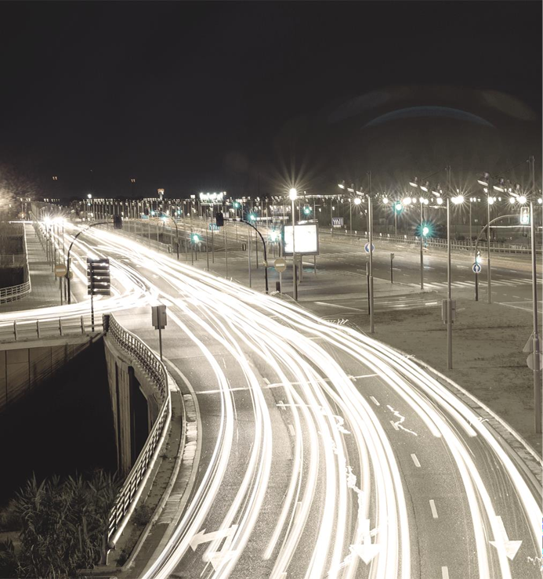
Future Work & Expected Outcomes
Future Work:
Finalize the EV and plug-in hybrid designs.
Develop and test prototypes for performance.
Conduct financial and environmental analyses.
Expected Outcomes:
Functional prototypes demonstrating technical feasibility.
Scalable solutions for Sri Lanka’s transportation needs.
Policy recommendations for EV adoption.

Slide 13


Conclusion
Summary:
EV conversions address environmental and economic challenges in Sri Lanka.
Plug-in hybrid models offer flexibility and reliability for diverse user needs.
Combines innovative design, global practices, and local applicability.

Slide 14

Thank You

